Slide 1
Back to the Drawing Board:
Building Containers with SBoMs
Nisha Kumar
KubeCon/CloudNativeCon 2021
@nishakmr
Notes:
Hello and welcome to my talk: back to the drawing board – building containers with SBoMs
I'm Nisha Kumar
I am a Senior Open Source Engineer at Vmware

Slide 2
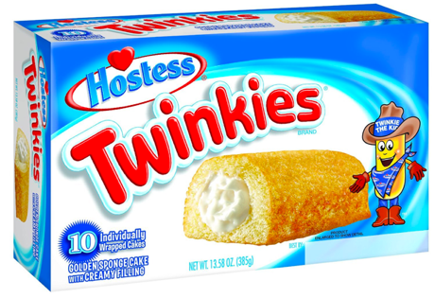

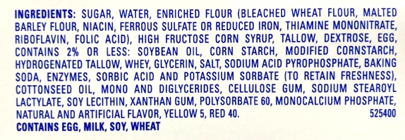
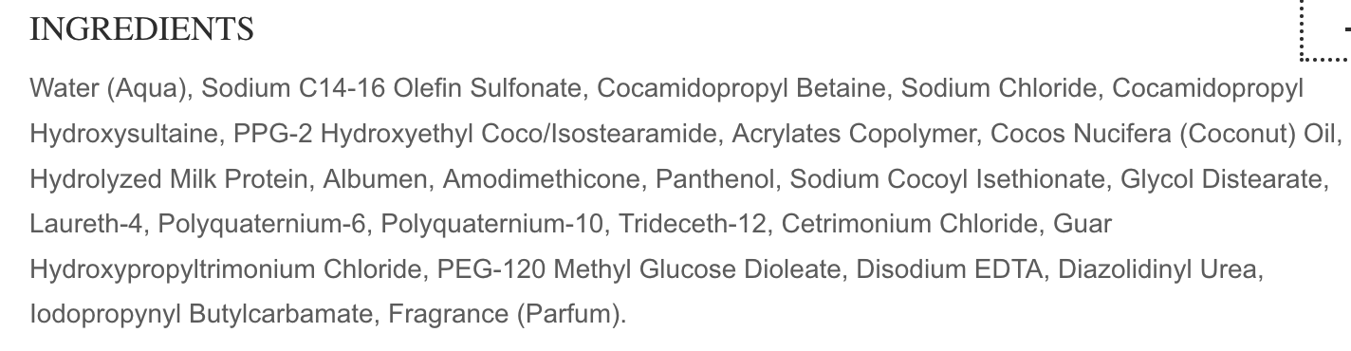
What is an SBOM?
Notes:
I’m hoping you’ve gotten enough messaging about SBOMs and why we need them
But if you haven’t, here are a couple of analogies
If you’ve ever looked at the ingredents on a product’s packaging, you may be surprised at what you find.
For example, twinkies are not vegetarian and coconut milk conditioner does not have coconut milk!

Slide 3
Why build SBOMs at container build time?
”Desktop” Image
Multistage Image
Runtime Image
App
App
App Deps
Run Time Deps
Files + App
System Deps
OS
OS
Notes:
Next you are probably wondering what is wrong with the situation we have now where we use our favorite security scanner?
I’ve got news for you: the security scanner is only as good as the metadata in the container image.
As we make container images smaller and smaller with multistage docker builds and slimming tools like Docker slim, we lose all of the metadata scanners typically need to make inferences.

Slide 4
Building Transparency Into Container Builds
SBOM4
App
SBOM4
SBOM3
+
App Deps
+
SBOM3
Files + App
SBOM2
System Deps
SBOM2
SBOM1
OS
SBOM1
Notes:
How do we fix this?
How many of you thought: eBPF!
Yeah, I know we all run after the shiny new thing.
But we don’t need to do things like inspect the docker build logs or watch the kernel, or do nmap scans.
Container builders already know some portion of what they are installing
If Container builders can create accurate SBOMs for the pieces they are installing and reuse SBOMs created by others, be it a module packager, or an OS supplier, or the maintainer of an open source project, then they can include them into the container distribution ecosystem.
What that does is maintain a set of metadata for a specific image, even if that image is as small as possible. You keep the attack surface small while maintaining the metadata about the containers used during the build process.

Slide 5




A Starting Point
Notes:
How do we accomplish this? We have to deconstruct the container build process.
Here I am going to show you how we can integrate transparency into the container supply chain
We will use Buildah, for building the container,
Tern for generating the SBOM
ORAS CLI for pushing the SBOM to a registry.
And Sigstore cosign for signing all the things we created.

Slide 6
DEMO!

Slide 7
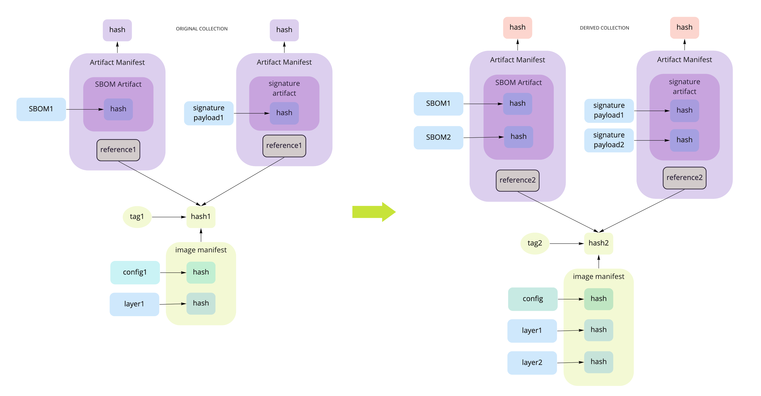
Filling in the Gaps – Artifact Management
Notes:
This is already itchy to me. There is a big gap.
You may have noticed in the demo that we created a lot of repositories and tags!
This is because container registries are not made to support supplemental artifacts that need to reference a container image i.e. there isn’t anything in the OCI distribution spec that says we can organize container images or artifacts in a specific hierarchy so we can find them. At this time they need to be managed outside of the OCI ecosystem. This is where the OCI artifacts come into play.
With OCI artifacts you can create references to from the SBOMs to the container image such that the registry can serve that information to clients.
You can also move the containers from one registry to another without keeping track of all the associated repos and tags!
The image shows what happens when you use references when you create derived container images:
A new image hash is created, and new OCI artifact manifests are created containing references to the image. As a result, the image and the SBOMs can be referenced with just one tag.
This means, in the demo, rather than creating a new repo debian-sbom:10 we create a reference to debian:10 within the new sbom artifact and upload it.

Slide 8
Where to get involved
OCI Artifact References: https://github.com/opencontainers/tob/blob/master/proposals/artifacts.md
Tern Community Meetings: https://github.com/tern-tools/tern#community-meetings
TUF: https://theupdateframework.io/
Implementers of TUF: https://github.com/sigstore
Notes:
Here’s where you can get involved in improving the state of the art for the container build and distribution ecosystem.
Take a look at the OCI Artifacts References proposal and working group. See if it works for your use case. The proposal requires changes to distribution, formerly known as docker-distribution, and changes to the OCI image specification.
Get involved with Tern! We are always looking for use cases that Tern can fulfill. Feedback and contributions are welcome!
Get involved with The Update Framework. There is work currently being done to apply TUF to container registries.
And of course, the sigstore community which is doing great work in making signing and verifying easy.

Slide 9
Resources
The Demo: https://github.com/vmware-samples/containers-with-sboms
Ask me on Twitter: @nishakm
Slack channels: CNCF, OCI, sigstore
IRC: #tern on irc.libera.chat
Notes:
I don’t expect contributions to this repo, but file an issue if something doesn’t work for you.
I am available on Twitter if you have any ideas or want to discuss more improvements.
I also lurk on all of these public slack channels. If IRC is your thing, then I hang out at #tern

Slide 10
Thank You!
Q&A
#ossummit @nishakmr

